Slide 1
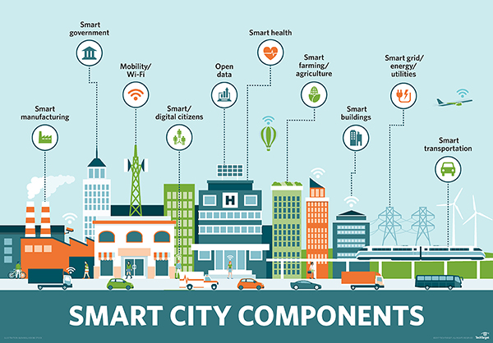


Dr. Kris Singh – March 2018
Calvin Ho
Jessica Ng
Maximilian Stork
Xu Xin
Yan Qiuhe
Zhang Tianhao
IEDE Module– Tsinghua University - Futurama
(Source: Yahoo! Images)

Slide 2

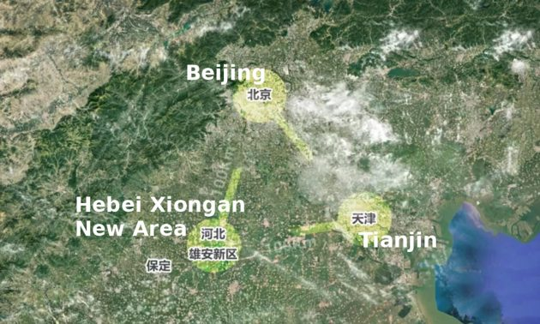
(Source: Miaopai)

Slide 3

OUTLINE
The Concept of the Smart City
Smart Cities Index 2017
Smart(er) Solutions: Lighting
The Challenges

Slide 4

Why Do ‘Smart Cities’ Exist?
Rapid Urbanization
Support/ Enhancing Infrastructure
Universal Problem: Lack ability to capitalize on shared resources / innovation between sectors.
Overcrowded Population
Cons: Heavy Increase in Energy Consumption
Cons: Usage of Carbon Emissions

Slide 5

Rural & Urban Populations

Slide 6

The Role of Governments in Smart Cities
Facilitate Conflicts
Citizens
Exchanging Information
Investment in creation of transparent procedures by providing citizens and institutions in new mediums for governance and social inclusion.
Citizens have knowledge to demand change and act as a catalyst for innovation and improvement.
Stay connected and things become more accessible.
The public can be engaged in decision making.
Citizens can vote electronically and create dialogue on elected officials.
Utilization of information and communication technology have the potential to create an electronic democracy.
(Source: Bloomberg)

Slide 7
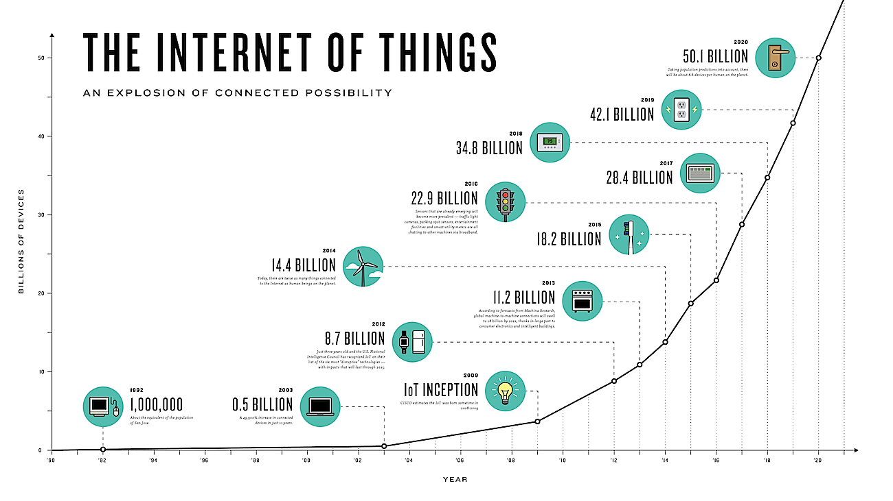
The IoT (Internet of Things)
(Source: AT&T Smart City Report 2017)

Slide 8



The Magic of iOt
The magic of technological innovation:
Yes…But
Cost-Effective
Global Connection
Innovative
Efficient
Cost Effective
Interconnected
Environmental surroundings:
Parking Spaces
Street Lights
Appliances
Cars
Mobile Devices
No city is up to date yet with fully integrated smart technology. This will take several years…
The cost, benefits, and the difficulties that come with the implementation of the “best-tech” smart city development.
Invasion of human privacy?!

Slide 9

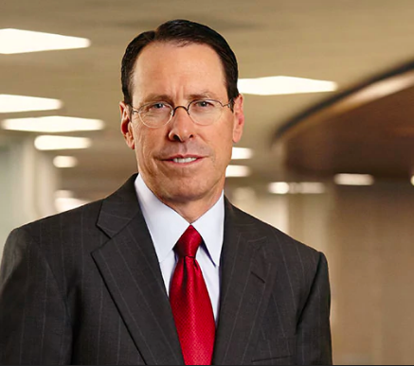
“The surge of connected devices shows there are endless possibilities for building smart cities. With more than 23 million connected devices globally we’re building IoT platforms that create a sustainable world.”
Randall Stephenson, President & CEO
AT&T Mobility

Slide 10
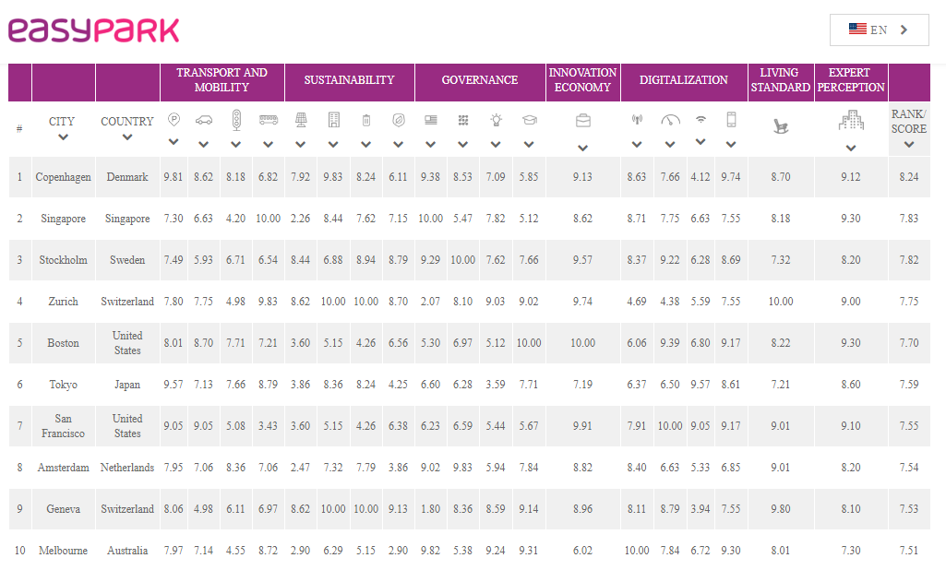
2017 Smart Cities Index
(Source: EasyPark Smart City Report 2017)

Slide 11
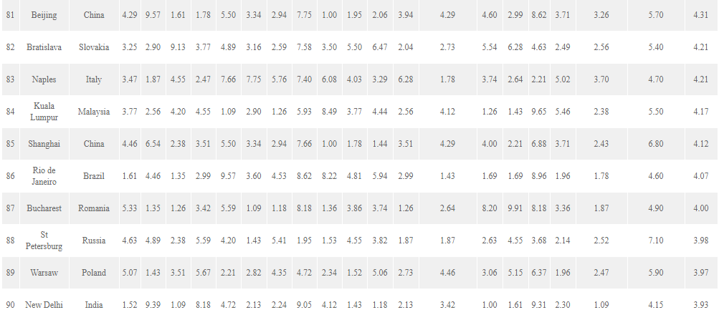
2017 Smart Cities Index
(Source: EasyPark Smart City Report 2017)

Slide 12
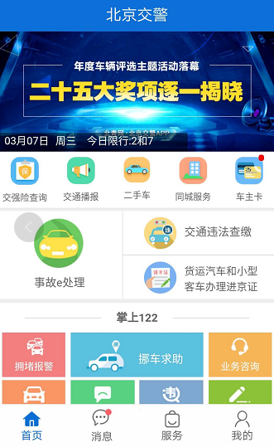
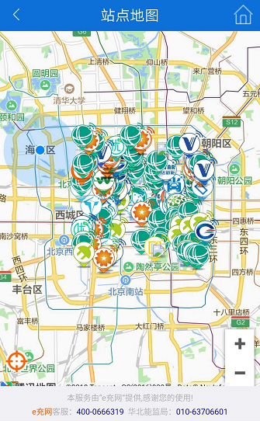
Beijing Transport and Mobility
(Source: Beijing Jiaojing)

Slide 13
Neon Lighting at Zijing Apartment No. 20
Study Room
Corridor
Room

Slide 14
The Cost of Lighting
Study Room: 1,750 yuan/year
Corridor: 5,900 yuan/year
Room: 62,200 yuan/year
Total: 69,850 yuan/year

Slide 15
Simple Solutions
Neon to LED
Motion Sensor

Slide 16
Lighting at Zijing Apartment No. 20
Study Room: Save 900 yuan/year
Corridor: Save 4,100 yuan/year
Room: Save 42,000 yuan/year
Total: Save 47,000 yuan/year

Slide 17
Challenges
Data Theft
Cyber Crime
Technical Decisions
Political Will

